Slide 1

Commonwealth Bank SQL Project (Aggregations)
Michael Le

Slide 2

Requirements
Install and Download SQL Server Express (2022,or 2025 (much preferred)) from Microsoft
Files and sources from my repository:
https://github.com/Mikele02171/Main-Stuff/tree/main/DA%20Bootcamp%202026%20Emergi%20Mentors/Week%202%20SQL%20Mastery/Module%202%20SQL%20for%20Business%20Analytics%20Beginner%20Projects/Credit_Card_Transaction_Dashboard_Story

Slide 3
Context
DDL and DML: Create CBA Cardholders Tables
DDL and DML: Create CBA Transactions
DQL: How much revenue did each card tier generate in November?
DQL: Complete Executive Dashboard (Multiple Aggregates)
DQL: ONLY tiers with total revenue over $10,000
DQL: Who are our top 10 spenders?
DQL: Segment ALL customers by spending: Low/Medium/High
DQL: Which merchant categories drive the most revenue?

Slide 4
DDL: Create CBA Cardholders Tables
-- Table 1: Cardholders (customer master data)
IF OBJECT_ID('cba_cardholders', 'U') IS NOT NULL DROP TABLE cba_cardholders;
CREATE TABLE cba_cardholders (
card_number VARCHAR(20) PRIMARY KEY,
customer_name VARCHAR(100),
card_tier VARCHAR(20),
annual_fee DECIMAL(10,2),
credit_limit DECIMAL(10,2),
signup_date DATE
);

Slide 5
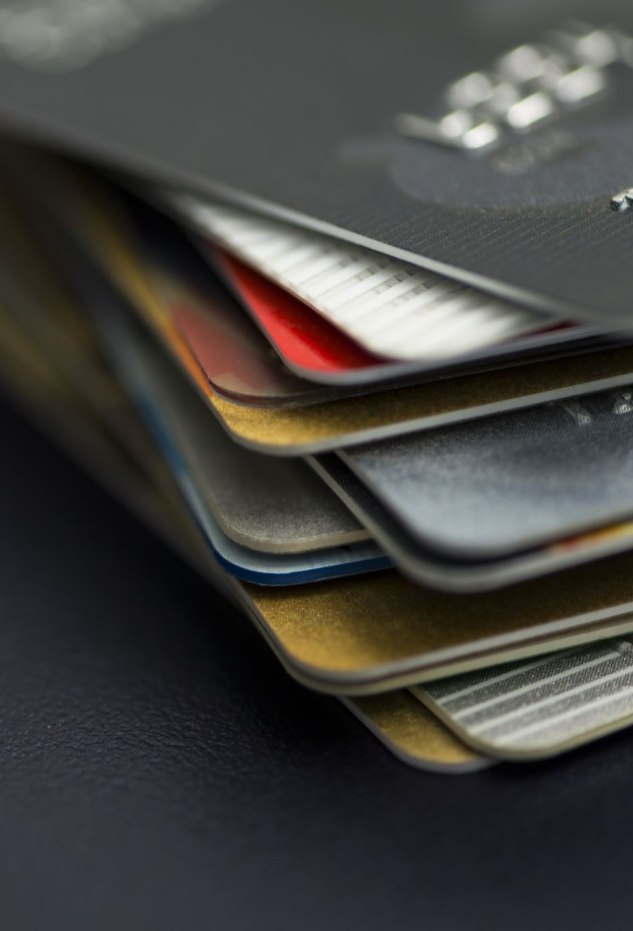
DML: Create CBA Cardholders Tables Platinum cardholders
-- Insert cardholders with card tiers
INSERT INTO cba_cardholders VALUES
-- Platinum cardholders (annual fee: $599)
('4532-****-1001', 'Sarah Mitchell', 'Platinum', 599.00, 50000, '2022-01-15'),
('4532-****-1002', 'James Chen', 'Platinum', 599.00, 75000, '2021-06-22'),
('4532-****-1003', 'Emma Thompson', 'Platinum', 599.00, 60000, '2023-03-10'),
('4532-****-1004', 'Michael Rodriguez', 'Platinum', 599.00, 100000, '2020-11-08'),
('4532-****-1005', 'Olivia Zhang', 'Platinum', 599.00, 80000, '2022-09-14'),
('4532-****-1006', 'Daniel Kim', 'Platinum', 599.00, 65000, '2021-12-03'),
('4532-****-1007', 'Sophie Williams', 'Platinum', 599.00, 70000, '2023-02-18'),
('4532-****-1008', 'Alexander Brown', 'Platinum', 599.00, 55000, '2022-07-25'),
('4532-****-1009', 'Isabella Martinez', 'Platinum', 599.00, 90000, '2021-04-12'),

Slide 6
DML: Create CBA Cardholders Tables Gold cardholders
-- Gold cardholders (annual fee: $395)
('4532-****-2001', 'Ryan Patel', 'Gold', 395.00, 35000, '2023-01-20'),
('4532-****-2002', 'Jessica Lee', 'Gold', 395.00, 40000, '2022-05-15'),
('4532-****-2003', 'Thomas Wilson', 'Gold', 395.00, 30000, '2023-06-08'),
('4532-****-2004', 'Emily Davis', 'Gold', 395.00, 38000, '2022-03-22'),
('4532-****-2005', 'David Anderson', 'Gold', 395.00, 42000, '2023-08-10'),
('4532-****-2006', 'Rachel Taylor', 'Gold', 395.00, 33000, '2022-11-05'),
('4532-****-2007', 'Kevin Moore', 'Gold', 395.00, 36000, '2023-04-18'),
('4532-****-2008', 'Lauren White', 'Gold', 395.00, 39000, '2022-09-30'),
('4532-****-2009', 'Christopher Harris', 'Gold', 395.00, 35000, '2023-07-14'),
('4532-****-2010', 'Amanda Clark', 'Gold', 395.00, 37000, '2022-12-20'),

Slide 7
DML: Create CBA Cardholders Tables Silver and Bronze cardholders
-- Silver cardholders (annual fee: $195)
('4532-****-3001', 'Brandon Lewis', 'Silver', 195.00, 15000, '2023-02-12'),
('4532-****-3002', 'Stephanie Walker', 'Silver', 195.00, 18000, '2023-05-28'),
('4532-****-3003', 'Justin Hall', 'Silver', 195.00, 16000, '2023-03-15'),
('4532-****-3004', 'Nicole Young', 'Silver', 195.00, 20000, '2023-08-22'),
('4532-****-3005', 'Andrew Allen', 'Silver', 195.00, 17000, '2023-01-30'),
('4532-****-3006', 'Megan King', 'Silver', 195.00, 19000, '2023-06-10'),
('4532-****-3007', 'Tyler Wright', 'Silver', 195.00, 15500, '2023-04-05'),
('4532-****-3008', 'Kimberly Scott', 'Silver', 195.00, 18500, '2023-09-18'),
-- Bronze cardholders (annual fee: $0)
('4532-****-4001', 'Eric Green', 'Bronze', 0.00, 5000, '2023-07-15'),
('4532-****-4002', 'Ashley Adams', 'Bronze', 0.00, 7500, '2023-08-20'),
('4532-****-4003', 'Brian Baker', 'Bronze', 0.00, 6000, '2023-09-05'),
('4532-****-4004', 'Michelle Nelson', 'Bronze', 0.00, 8000, '2023-10-12'),
('4532-****-4005', 'Joshua Carter', 'Bronze', 0.00, 5500, '2023-06-25'),
('4532-****-4006', 'Rebecca Mitchell', 'Bronze', 0.00, 7000, '2023-11-08');

Slide 8
DDL: Create CBA Transactions
IF OBJECT_ID('cba_transactions', 'U') IS NOT NULL DROP TABLE cba_transactions;
CREATE TABLE cba_transactions (
transaction_id INT PRIMARY KEY,
card_number VARCHAR(20),
transaction_date DATE,
merchant_name VARCHAR(100),
merchant_category VARCHAR(50),
amount DECIMAL(10,2),
city VARCHAR(50),
state VARCHAR(3)
);

Slide 9
DML: Create CBA Transactions Premium Part 1
INSERT INTO cba_transactions VALUES
-- PLATINUM TIER TRANSACTIONS (High spenders: $150-$3000 per transaction)
-- Sarah Mitchell (1001) - Frequent high-value traveler
(1, '4532-****-1001', '2024-11-01', 'Qantas', 'Travel', 2899.00, 'Sydney', 'NSW'),
(2, '4532-****-1001', '2024-11-05', 'Woolworths', 'Supermarket', 187.50, 'Sydney', 'NSW'),
(3, '4532-****-1001', '2024-11-10', 'David Jones', 'Department Store', 1245.00, 'Sydney', 'NSW'),
(4, '4532-****-1001', '2024-11-15', 'Caltex Fuel', 'Fuel', 95.00, 'Sydney', 'NSW'),
(5, '4532-****-1001', '2024-11-20', 'Virgin Australia', 'Travel', 1678.00, 'Sydney', 'NSW'),
(6, '4532-****-1001', '2024-11-25', 'Myer', 'Department Store', 567.00, 'Sydney', 'NSW'),
(7, '4532-****-1001', '2024-11-28', 'Coles', 'Supermarket', 234.50, 'Sydney', 'NSW'),
-- James Chen (1002) - Tech enthusiast & luxury spender
(8, '4532-****-1002', '2024-11-02', 'Apple Store', 'Electronics', 2899.00, 'Melbourne', 'VIC'),
(9, '4532-****-1002', '2024-11-07', 'Flight Centre', 'Travel', 3450.00, 'Melbourne', 'VIC'),
(10, '4532-****-1002', '2024-11-12', 'JB Hi-Fi', 'Electronics', 1567.00, 'Melbourne', 'VIC'),
(11, '4532-****-1002', '2024-11-16', 'Woolworths', 'Supermarket', 156.80, 'Melbourne', 'VIC'),
(12, '4532-****-1002', '2024-11-22', 'Harvey Norman', 'Electronics', 2134.00, 'Melbourne', 'VIC'),
(13, '4532-****-1002', '2024-11-27', 'Dan Murphys', 'Liquor', 345.00, 'Melbourne', 'VIC'),
-- Emma Thompson (1003) - Premium shopper
(14, '4532-****-1003', '2024-11-03', 'Webjet', 'Travel', 2567.00, 'Brisbane', 'QLD'),
(15, '4532-****-1003', '2024-11-08', 'David Jones', 'Department Store', 1890.00, 'Brisbane', 'QLD'),
(16, '4532-****-1003', '2024-11-14', 'Coles', 'Supermarket', 189.40, 'Brisbane', 'QLD'),
(17, '4532-****-1003', '2024-11-19', 'Bunnings', 'Hardware', 678.90, 'Brisbane', 'QLD'),
(18, '4532-****-1003', '2024-11-24', 'Jetstar', 'Travel', 1234.00, 'Brisbane', 'QLD'),
(19, '4532-****-1003', '2024-11-29', 'Myer', 'Department Store', 456.00, 'Brisbane', 'QLD'),

Slide 10
DML: Create CBA Transactions Premium Part 2
-- Michael Rodriguez (1004) - Highest spender
(20, '4532-****-1004', '2024-11-04', 'Qantas', 'Travel', 4567.00, 'Sydney', 'NSW'),
(21, '4532-****-1004', '2024-11-09', 'Apple Store', 'Electronics', 3899.00, 'Sydney', 'NSW'),
(22, '4532-****-1004', '2024-11-13', 'David Jones', 'Department Store', 2345.00, 'Sydney', 'NSW'),
(23, '4532-****-1004', '2024-11-18', 'Woolworths', 'Supermarket', 267.80, 'Sydney', 'NSW'),
(24, '4532-****-1004', '2024-11-23', 'Flight Centre', 'Travel', 5678.00, 'Sydney', 'NSW'),
(25, '4532-****-1004', '2024-11-26', 'JB Hi-Fi', 'Electronics', 1789.00, 'Sydney', 'NSW'),
-- Olivia Zhang (1005)
(26, '4532-****-1005', '2024-11-01', 'Virgin Australia', 'Travel', 1567.00, 'Perth', 'WA'),
(27, '4532-****-1005', '2024-11-11', 'Myer', 'Department Store', 1234.00, 'Perth', 'WA'),
(28, '4532-****-1005', '2024-11-17', 'Woolworths', 'Supermarket', 178.90, 'Perth', 'WA'),
(29, '4532-****-1005', '2024-11-21', 'Harvey Norman', 'Electronics', 2890.00, 'Perth', 'WA'),
(30, '4532-****-1005', '2024-11-28', 'Coles', 'Supermarket', 203.40, 'Perth', 'WA'),
-- Daniel Kim (1006)
(31, '4532-****-1006', '2024-11-06', 'Webjet', 'Travel', 2234.00, 'Adelaide', 'SA'),
(32, '4532-****-1006', '2024-11-12', 'David Jones', 'Department Store', 987.00, 'Adelaide', 'SA'),
(33, '4532-****-1006', '2024-11-19', 'Bunnings', 'Hardware', 567.80, 'Adelaide', 'SA'),
(34, '4532-****-1006', '2024-11-25', 'Coles', 'Supermarket', 156.70, 'Adelaide', 'SA'),

Slide 11
DML: Create CBA Transactions Platinum Part 3
-- Sophie Williams (1007)
(35, '4532-****-1007', '2024-11-05', 'Qantas', 'Travel', 1890.00, 'Sydney', 'NSW'),
(36, '4532-****-1007', '2024-11-15', 'Apple Store', 'Electronics', 2567.00, 'Sydney', 'NSW'),
(37, '4532-****-1007', '2024-11-20', 'Woolworths', 'Supermarket', 189.50, 'Sydney', 'NSW'),
(38, '4532-****-1007', '2024-11-27', 'Myer', 'Department Store', 1123.00, 'Sydney', 'NSW'),
-- Alexander Brown (1008)
(39, '4532-****-1008', '2024-11-08', 'Virgin Australia', 'Travel', 1456.00, 'Melbourne', 'VIC'),
(40, '4532-****-1008', '2024-11-14', 'JB Hi-Fi', 'Electronics', 1678.00, 'Melbourne', 'VIC'),
(41, '4532-****-1008', '2024-11-22', 'Coles', 'Supermarket', 167.90, 'Melbourne', 'VIC'),
(42, '4532-****-1008', '2024-11-29', 'Dan Murphys', 'Liquor', 234.50, 'Melbourne', 'VIC'),
-- Isabella Martinez (1009)
(43, '4532-****-1009', '2024-11-03', 'Flight Centre', 'Travel', 3890.00, 'Brisbane', 'QLD'),
(44, '4532-****-1009', '2024-11-13', 'David Jones', 'Department Store', 1567.00, 'Brisbane', 'QLD'),
(45, '4532-****-1009', '2024-11-18', 'Harvey Norman', 'Electronics', 2345.00, 'Brisbane', 'QLD'),
(46, '4532-****-1009', '2024-11-26', 'Woolworths', 'Supermarket', 198.70, 'Brisbane', 'QLD'),

Slide 12
DML: Create CBA Transactions Gold Part 1
-- GOLD TIER TRANSACTIONS (Moderate spenders: $50-$1500 per transaction)
-- Ryan Patel (2001)
(47, '4532-****-2001', '2024-11-02', 'Woolworths', 'Supermarket', 134.50, 'Sydney', 'NSW'),
(48, '4532-****-2001', '2024-11-09', 'Jetstar', 'Travel', 567.00, 'Sydney', 'NSW'),
(49, '4532-****-2001', '2024-11-16', 'JB Hi-Fi', 'Electronics', 789.00, 'Sydney', 'NSW'),
(50, '4532-****-2001', '2024-11-23', 'Coles', 'Supermarket', 98.60, 'Sydney', 'NSW'),
(51, '4532-****-2001', '2024-11-28', 'Bunnings', 'Hardware', 345.00, 'Sydney', 'NSW'),
-- Jessica Lee (2002)
(52, '4532-****-2002', '2024-11-04', 'Virgin Australia', 'Travel', 789.00, 'Melbourne', 'VIC'),
(53, '4532-****-2002', '2024-11-11', 'Myer', 'Department Store', 456.00, 'Melbourne', 'VIC'),
(54, '4532-****-2002', '2024-11-17', 'Woolworths', 'Supermarket', 112.30, 'Melbourne', 'VIC'),
(55, '4532-****-2002', '2024-11-24', 'Kmart', 'Department Store', 234.00, 'Melbourne', 'VIC'),
(56, '4532-****-2002', '2024-11-30', 'Coles', 'Supermarket', 87.50, 'Melbourne', 'VIC'),
-- Thomas Wilson (2003)
(57, '4532-****-2003', '2024-11-05', 'Webjet', 'Travel', 1234.00, 'Brisbane', 'QLD'),
(58, '4532-****-2003', '2024-11-12', 'Harvey Norman', 'Electronics', 567.00, 'Brisbane', 'QLD'),
(59, '4532-****-2003', '2024-11-19', 'Woolworths', 'Supermarket', 145.80, 'Brisbane', 'QLD'),
(60, '4532-****-2003', '2024-11-26', 'Bunnings', 'Hardware', 289.00, 'Brisbane', 'QLD'),
-- Emily Davis (2004)
(61, '4532-****-2004', '2024-11-07', 'David Jones', 'Department Store', 678.00, 'Perth', 'WA'),
(62, '4532-****-2004', '2024-11-14', 'Coles', 'Supermarket', 123.40, 'Perth', 'WA'),
(63, '4532-****-2004', '2024-11-21', 'JB Hi-Fi', 'Electronics', 890.00, 'Perth', 'WA'),
(64, '4532-****-2004', '2024-11-27', 'Woolworths', 'Supermarket', 98.70, 'Perth', 'WA'),

Slide 13
DML: Create CBA Transactions Gold Part 2
-- David Anderson (2005)
(65, '4532-****-2005', '2024-11-03', 'Qantas', 'Travel', 934.00, 'Adelaide', 'SA'),
(66, '4532-****-2005', '2024-11-10', 'Target', 'Department Store', 345.00, 'Adelaide', 'SA'),
(67, '4532-****-2005', '2024-11-18', 'Coles', 'Supermarket', 134.60, 'Adelaide', 'SA'),
(68, '4532-****-2005', '2024-11-25', 'Bunnings', 'Hardware', 456.00, 'Adelaide', 'SA'),
-- Rachel Taylor (2006)
(69, '4532-****-2006', '2024-11-06', 'Virgin Australia', 'Travel', 678.00, 'Sydney', 'NSW'),
(70, '4532-****-2006', '2024-11-13', 'Myer', 'Department Store', 567.00, 'Sydney', 'NSW'),
(71, '4532-****-2006', '2024-11-20', 'Woolworths', 'Supermarket', 109.50, 'Sydney', 'NSW'),
(72, '4532-****-2006', '2024-11-28', 'Kmart', 'Department Store', 198.00, 'Sydney', 'NSW'),
-- Kevin Moore (2007)
(73, '4532-****-2007', '2024-11-08', 'Jetstar', 'Travel', 567.00, 'Melbourne', 'VIC'),
(74, '4532-****-2007', '2024-11-15', 'Harvey Norman', 'Electronics', 734.00, 'Melbourne', 'VIC'),
(75, '4532-****-2007', '2024-11-22', 'Coles', 'Supermarket', 87.90, 'Melbourne', 'VIC'),
(76, '4532-****-2007', '2024-11-29', 'Woolworths', 'Supermarket', 112.30, 'Melbourne', 'VIC'),
-- Lauren White (2008)
(77, '4532-****-2008', '2024-11-04', 'Webjet', 'Travel', 890.00, 'Brisbane', 'QLD'),
(78, '4532-****-2008', '2024-11-11', 'David Jones', 'Department Store', 456.00, 'Brisbane', 'QLD'),
(79, '4532-****-2008', '2024-11-18', 'Woolworths', 'Supermarket', 123.70, 'Brisbane', 'QLD'),
(80, '4532-****-2008', '2024-11-25', 'JB Hi-Fi', 'Electronics', 567.00, 'Brisbane', 'QLD'),

Slide 14
DML: Create CBA Transactions Gold Part 3
-- Christopher Harris (2009)
(81, '4532-****-2009', '2024-11-05', 'Qantas', 'Travel', 1123.00, 'Perth', 'WA'),
(82, '4532-****-2009', '2024-11-12', 'Bunnings', 'Hardware', 345.00, 'Perth', 'WA'),
(83, '4532-****-2009', '2024-11-19', 'Coles', 'Supermarket', 98.50, 'Perth', 'WA'),
(84, '4532-****-2009', '2024-11-26', 'Myer', 'Department Store', 678.00, 'Perth', 'WA'),
-- Amanda Clark (2010)
(85, '4532-****-2010', '2024-11-07', 'Virgin Australia', 'Travel', 734.00, 'Adelaide', 'SA'),
(86, '4532-****-2010', '2024-11-14', 'Target', 'Department Store', 289.00, 'Adelaide', 'SA'),
(87, '4532-****-2010', '2024-11-21', 'Woolworths', 'Supermarket', 145.30, 'Adelaide', 'SA'),
(88, '4532-****-2010', '2024-11-28', 'Harvey Norman', 'Electronics', 567.00, 'Adelaide', 'SA'),

Slide 15
DML: Create CBA Transactions Silver Part 1
-- Brandon Lewis (3001)
(89, '4532-****-3001', '2024-11-02', 'Woolworths', 'Supermarket', 87.50, 'Sydney', 'NSW'),
(90, '4532-****-3001', '2024-11-10', 'Kmart', 'Department Store', 156.00, 'Sydney', 'NSW'),
(91, '4532-****-3001', '2024-11-17', 'Coles', 'Supermarket', 67.80, 'Sydney', 'NSW'),
(92, '4532-****-3001', '2024-11-24', 'Bunnings', 'Hardware', 234.00, 'Sydney', 'NSW'),
(93, '4532-****-3001', '2024-11-29', 'Woolworths', 'Supermarket', 98.40, 'Sydney', 'NSW'),
-- Stephanie Walker (3002)
(94, '4532-****-3002', '2024-11-05', 'Jetstar', 'Travel', 389.00, 'Melbourne', 'VIC'),
(95, '4532-****-3002', '2024-11-13', 'Target', 'Department Store', 178.00, 'Melbourne', 'VIC'),
(96, '4532-****-3002', '2024-11-20', 'Coles', 'Supermarket', 76.50, 'Melbourne', 'VIC'),
(97, '4532-****-3002', '2024-11-27', 'Kmart', 'Department Store', 134.00, 'Melbourne', 'VIC'),
-- Justin Hall (3003)
(98, '4532-****-3003', '2024-11-08', 'Woolworths', 'Supermarket', 102.30, 'Brisbane', 'QLD'),
(99, '4532-****-3003', '2024-11-15', 'Big W', 'Department Store', 189.00, 'Brisbane', 'QLD'),
(100, '4532-****-3003', '2024-11-22', 'Coles', 'Supermarket', 89.40, 'Brisbane', 'QLD'),
(101, '4532-****-3003', '2024-11-28', 'Bunnings', 'Hardware', 267.00, 'Brisbane', 'QLD'),
-- Nicole Young (3004)
(102, '4532-****-3004', '2024-11-06', 'Virgin Australia', 'Travel', 456.00, 'Perth', 'WA'),
(103, '4532-****-3004', '2024-11-14', 'Woolworths', 'Supermarket', 94.60, 'Perth', 'WA'),
(104, '4532-****-3004', '2024-11-21', 'Kmart', 'Department Store', 145.00, 'Perth', 'WA'),
(105, '4532-****-3004', '2024-11-28', 'Coles', 'Supermarket', 78.90, 'Perth', 'WA'),

Slide 16
DML: Create CBA Transactions Silver Part 2
-- Andrew Allen (3005)
(106, '4532-****-3005', '2024-11-09', 'Target', 'Department Store', 167.00, 'Adelaide', 'SA'),
(107, '4532-****-3005', '2024-11-16', 'Woolworths', 'Supermarket', 87.30, 'Adelaide', 'SA'),
(108, '4532-****-3005', '2024-11-23', 'Bunnings', 'Hardware', 198.00, 'Adelaide', 'SA'),
(109, '4532-****-3005', '2024-11-29', 'Coles', 'Supermarket', 102.50, 'Adelaide', 'SA'),
-- Megan King (3006)
(110, '4532-****-3006', '2024-11-04', 'Woolworths', 'Supermarket', 123.40, 'Sydney', 'NSW'),
(111, '4532-****-3006', '2024-11-12', 'Big W', 'Department Store', 178.00, 'Sydney', 'NSW'),
(112, '4532-****-3006', '2024-11-19', 'Coles', 'Supermarket', 91.20, 'Sydney', 'NSW'),
(113, '4532-****-3006', '2024-11-26', 'Kmart', 'Department Store', 156.00, 'Sydney', 'NSW'),
-- Tyler Wright (3007)
(114, '4532-****-3007', '2024-11-07', 'Jetstar', 'Travel', 334.00, 'Melbourne', 'VIC'),
(115, '4532-****-3007', '2024-11-15', 'Woolworths', 'Supermarket', 76.80, 'Melbourne', 'VIC'),
(116, '4532-****-3007', '2024-11-22', 'Target', 'Department Store', 134.00, 'Melbourne', 'VIC'),
(117, '4532-****-3007', '2024-11-28', 'Coles', 'Supermarket', 98.60, 'Melbourne', 'VIC'),
-- Kimberly Scott (3008)
(118, '4532-****-3008', '2024-11-03', 'Woolworths', 'Supermarket', 112.50, 'Brisbane', 'QLD'),
(119, '4532-****-3008', '2024-11-11', 'Kmart', 'Department Store', 189.00, 'Brisbane', 'QLD'),
(120, '4532-****-3008', '2024-11-18', 'Coles', 'Supermarket', 84.30, 'Brisbane', 'QLD'),
(121, '4532-****-3008', '2024-11-25', 'Bunnings', 'Hardware', 234.00, 'Brisbane', 'QLD'),

Slide 17
DML: Create CBA Transactions Bronze Part 1
-- Eric Green (4001)
(122, '4532-****-4001', '2024-11-05', 'Woolworths', 'Supermarket', 67.80, 'Sydney', 'NSW'),
(123, '4532-****-4001', '2024-11-12', 'Aldi', 'Supermarket', 45.60, 'Sydney', 'NSW'),
(124, '4532-****-4001', '2024-11-19', 'Coles', 'Supermarket', 54.30, 'Sydney', 'NSW'),
(125, '4532-****-4001', '2024-11-26', 'Woolworths', 'Supermarket', 72.50, 'Sydney', 'NSW'),
-- Ashley Adams (4002)
(126, '4532-****-4002', '2024-11-08', 'Kmart', 'Department Store', 89.00, 'Melbourne', 'VIC'),
(127, '4532-****-4002', '2024-11-15', 'Coles', 'Supermarket', 56.40, 'Melbourne', 'VIC'),
(128, '4532-****-4002', '2024-11-22', 'Woolworths', 'Supermarket', 78.90, 'Melbourne', 'VIC'),
(129, '4532-****-4002', '2024-11-28', 'Big W', 'Department Store', 112.00, 'Melbourne', 'VIC'),
-- Brian Baker (4003)
(130, '4532-****-4003', '2024-11-06', 'Aldi', 'Supermarket', 52.30, 'Brisbane', 'QLD'),
(131, '4532-****-4003', '2024-11-13', 'Coles', 'Supermarket', 64.80, 'Brisbane', 'QLD'),
(132, '4532-****-4003', '2024-11-20', 'Woolworths', 'Supermarket', 71.20, 'Brisbane', 'QLD'),
(133, '4532-****-4003', '2024-11-27', 'Kmart', 'Department Store', 98.00, 'Brisbane', 'QLD'),

Slide 18
DML: Create CBA Transactions Bronze Part 2
-- Michelle Nelson (4004)
(134, '4532-****-4004', '2024-11-09', 'Woolworths', 'Supermarket', 82.40, 'Perth', 'WA'),
(135, '4532-****-4004', '2024-11-16', 'Coles', 'Supermarket', 67.90, 'Perth', 'WA'),
(136, '4532-****-4004', '2024-11-23', 'Aldi', 'Supermarket', 49.50, 'Perth', 'WA'),
(137, '4532-****-4004', '2024-11-29', 'Woolworths', 'Supermarket', 73.60, 'Perth', 'WA'),
-- Joshua Carter (4005)
(138, '4532-****-4005', '2024-11-04', 'Coles', 'Supermarket', 58.70, 'Adelaide', 'SA'),
(139, '4532-****-4005', '2024-11-11', 'Woolworths', 'Supermarket', 76.30, 'Adelaide', 'SA'),
(140, '4532-****-4005', '2024-11-18', 'Big W', 'Department Store', 94.00, 'Adelaide', 'SA'),
(141, '4532-****-4005', '2024-11-25', 'Coles', 'Supermarket', 61.80, 'Adelaide', 'SA'),
-- Rebecca Mitchell (4006)
(142, '4532-****-4006', '2024-11-07', 'Woolworths', 'Supermarket', 69.50, 'Sydney', 'NSW'),
(143, '4532-****-4006', '2024-11-14', 'Aldi', 'Supermarket', 43.20, 'Sydney', 'NSW'),
(144, '4532-****-4006', '2024-11-21', 'Coles', 'Supermarket', 87.60, 'Sydney', 'NSW'),
(145, '4532-****-4006', '2024-11-28', 'Kmart', 'Department Store', 105.00, 'Sydney', 'NSW');

Slide 19
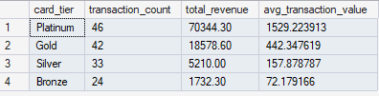
DQL: How much revenue did each card tier generate in November?
SELECT
c.card_tier,
COUNT(t.transaction_id) AS transaction_count,
SUM(t.amount) AS total_revenue,
AVG(t.amount) AS avg_transaction_value
FROM cba_transactions t
INNER JOIN cba_cardholders c ON t.card_number = c.card_number
WHERE t.transaction_date >= '2024-11-01'
AND t.transaction_date < '2024-12-01'
GROUP BY c.card_tier
ORDER BY total_revenue DESC;

Slide 20
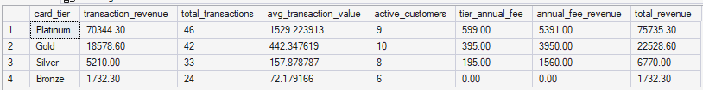
DQL: Complete Executive Dashboard (Multiple Aggregates)
SELECT
c.card_tier,
-- Transaction metrics
SUM(t.amount) AS transaction_revenue,
COUNT(t.transaction_id) AS total_transactions,
AVG(t.amount) AS avg_transaction_value,
-- Customer metrics
COUNT(DISTINCT t.card_number) AS active_customers,
-- Fee revenue
MAX(c.annual_fee) AS tier_annual_fee,
(COUNT(DISTINCT t.card_number) * MAX(c.annual_fee)) AS annual_fee_revenue,
-- Total revenue (transactions + fees)
SUM(t.amount) + (COUNT(DISTINCT t.card_number) * MAX(c.annual_fee)) AS total_revenue
FROM cba_transactions t
INNER JOIN cba_cardholders c ON t.card_number = c.card_number
WHERE t.transaction_date >= '2024-11-01'
AND t.transaction_date < '2024-12-01'
GROUP BY c.card_tier
ORDER BY total_revenue DESC;

Slide 21

DQL: ONLY tiers with total revenue over $10,000 in November 2024
SELECT
c.card_tier,
SUM(t.amount) AS total_revenue,
COUNT(t.transaction_id) AS transaction_count,
COUNT(DISTINCT t.card_number) AS active_customers,
AVG(t.amount) AS avg_transaction
FROM cba_transactions t
INNER JOIN cba_cardholders c ON t.card_number = c.card_number
WHERE t.transaction_date >= '2024-11-01'
AND t.transaction_date < '2024-12-01'
GROUP BY c.card_tier
HAVING SUM(t.amount) > 10000 -- Filter AFTER aggregation
ORDER BY total_revenue DESC;

Slide 22
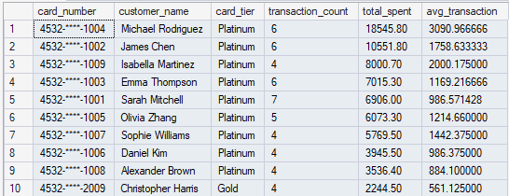
DQL: Who are our top 10 spenders?
SELECT TOP 10
t.card_number,
c.customer_name,
c.card_tier,
COUNT(t.transaction_id) AS transaction_count,
SUM(t.amount) AS total_spent,
AVG(t.amount) AS avg_transaction
FROM cba_transactions t
INNER JOIN cba_cardholders c ON t.card_number = c.card_number
WHERE t.transaction_date >= '2024-11-01'
AND t.transaction_date < '2024-12-01'
GROUP BY t.card_number, c.customer_name, c.card_tier
ORDER BY total_spent DESC;

Slide 23
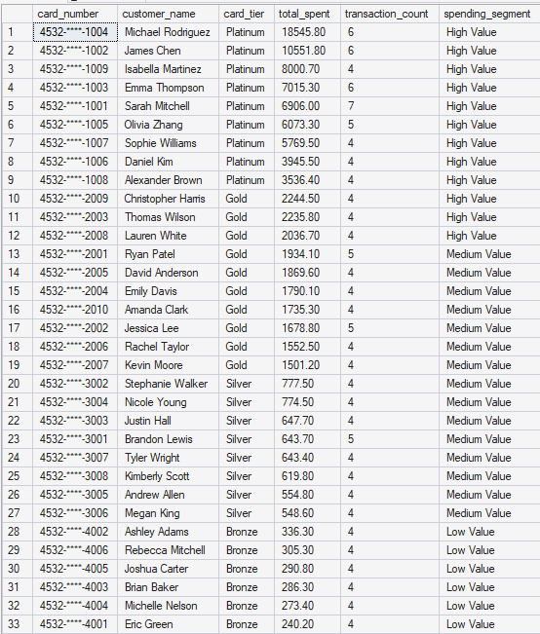
DQL: Segment ALL customers by spending: Low/Medium/High
SELECT
t.card_number,
c.customer_name,
c.card_tier,
SUM(t.amount) AS total_spent,
COUNT(t.transaction_id) AS transaction_count,
CASE
WHEN SUM(t.amount) < 500 THEN 'Low Value'
WHEN SUM(t.amount) >= 500 AND SUM(t.amount) < 2000 THEN 'Medium Value'
WHEN SUM(t.amount) >= 2000 THEN 'High Value'
END AS spending_segment
FROM cba_transactions t
INNER JOIN cba_cardholders c ON t.card_number = c.card_number
WHERE t.transaction_date >= '2024-11-01'
AND t.transaction_date < '2024-12-01'
GROUP BY t.card_number, c.customer_name, c.card_tier
ORDER BY total_spent DESC;

Slide 24
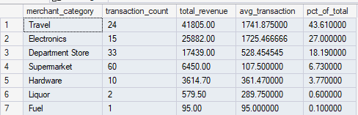
DQL: Which merchant categories drive the most revenue?
SELECT
merchant_category,
COUNT(transaction_id) AS transaction_count,
SUM(amount) AS total_revenue,
AVG(amount) AS avg_transaction,
ROUND(SUM(amount) * 100.0 / (SELECT SUM(amount) FROM cba_transactions
WHERE transaction_date >= '2024-11-01'
AND transaction_date < '2024-12-01'), 2) AS pct_of_total
FROM cba_transactions
WHERE transaction_date >= '2024-11-01'
AND transaction_date < '2024-12-01'
GROUP BY merchant_category
ORDER BY total_revenue DESC;

